Slide 1
Git hub repository URL for source code
https://github.com/Divyaraj-Mandale/Springboot-Project.git

Slide 2

LOCATION FORM
Team :- Divyaraj , Shreya , Parmeshwar , Priya , Sanatan

Slide 3
Problem Statement
Objective
Project Overview
Onboarding-Architecture
Project Flow
Technology and Tools Used
Conclusion
Outline

Slide 4
Problem Statement
XYZ wanted to fill his information So with the help of this form he can easily fill the form using this link
http://3.143.205.239:8095/show

Slide 5
Objective
Our objective is to provide best online location registration service to XYZ so that XYZ can Add, Update & Delete his location online without stepping outside.

Slide 6
On Boarding Architecture

Slide 7
Architecture
MySQL DB
Back-End
SpringBoot
FrameWork
java/Maven
POST request
Add Location
Update
Front End
HTML/JSP
Update
Update
Delete
Delete
Retrieve
Retrieve

Slide 8
Project Overview

Slide 9
Project Overview
Add Location
MySQL
Show Locations
Location form
Update Data
Delete data

Slide 10
Project Flow

Slide 11
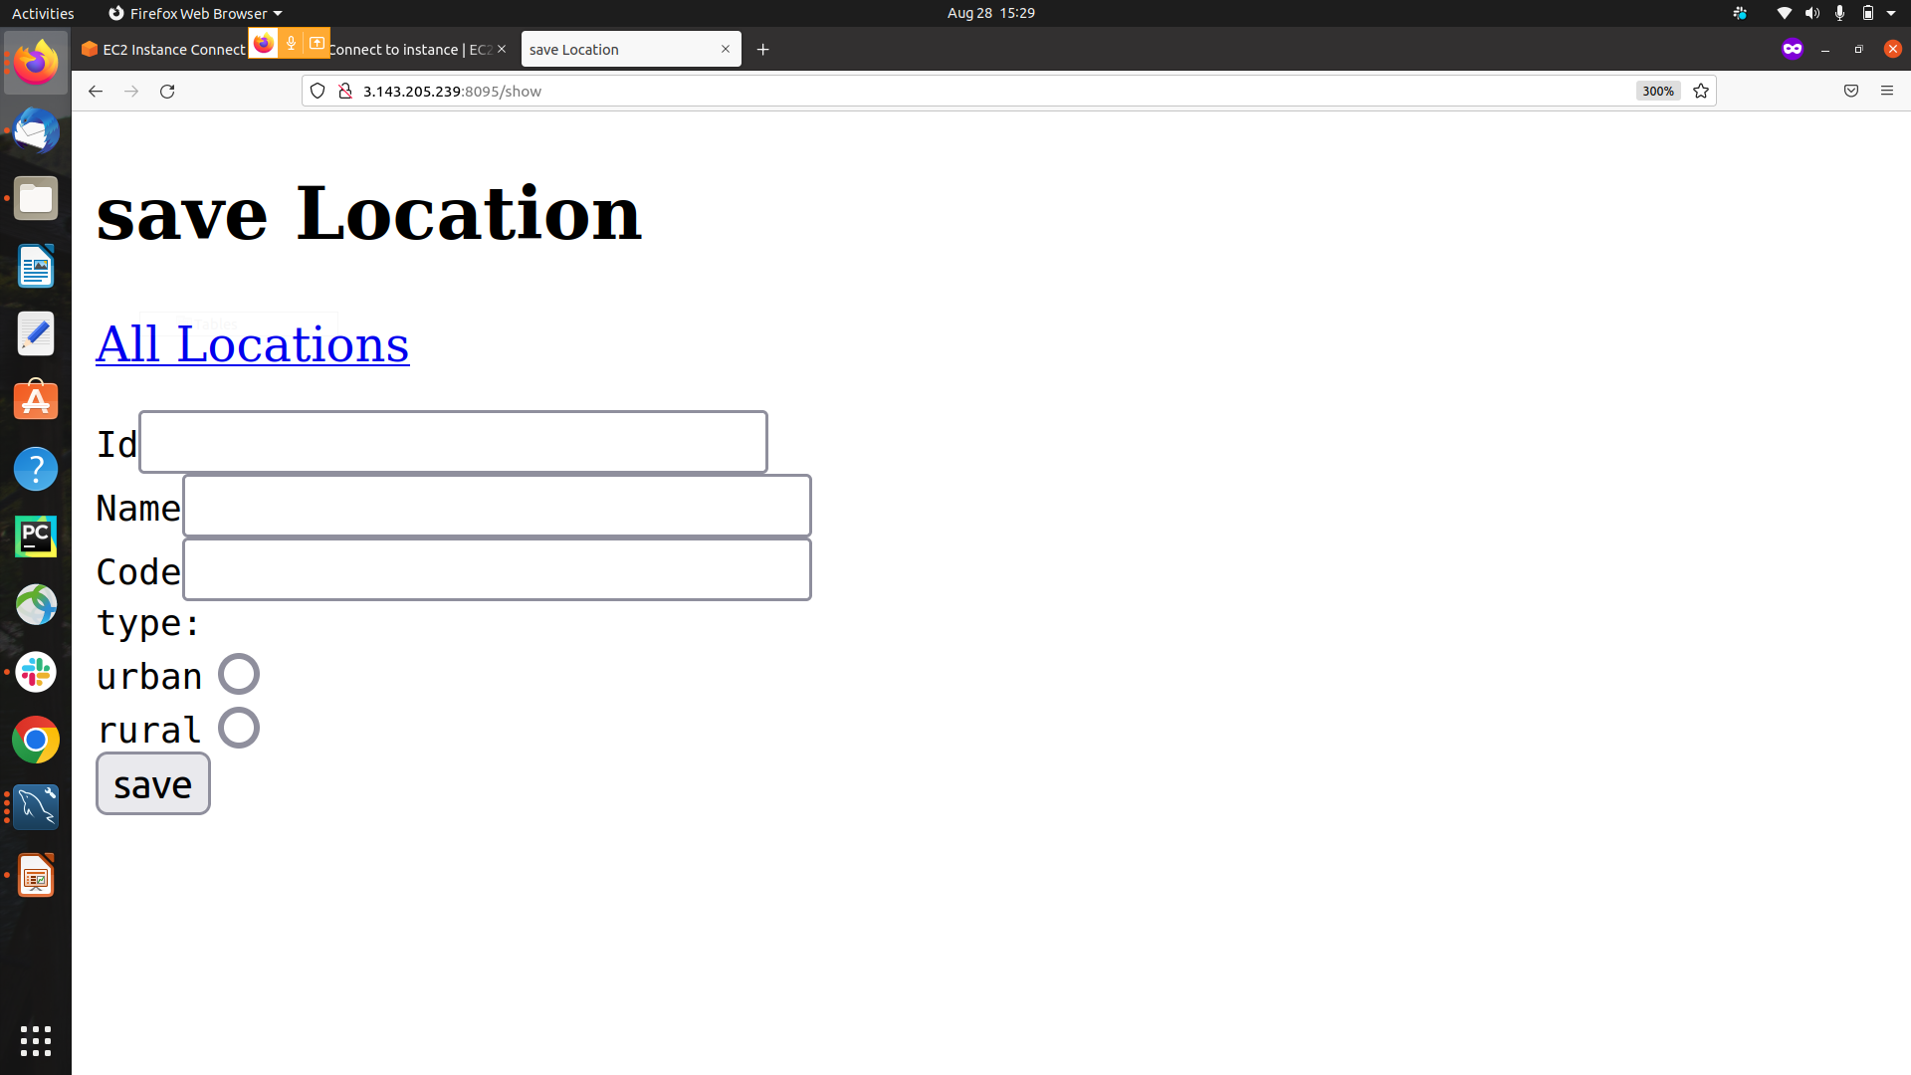
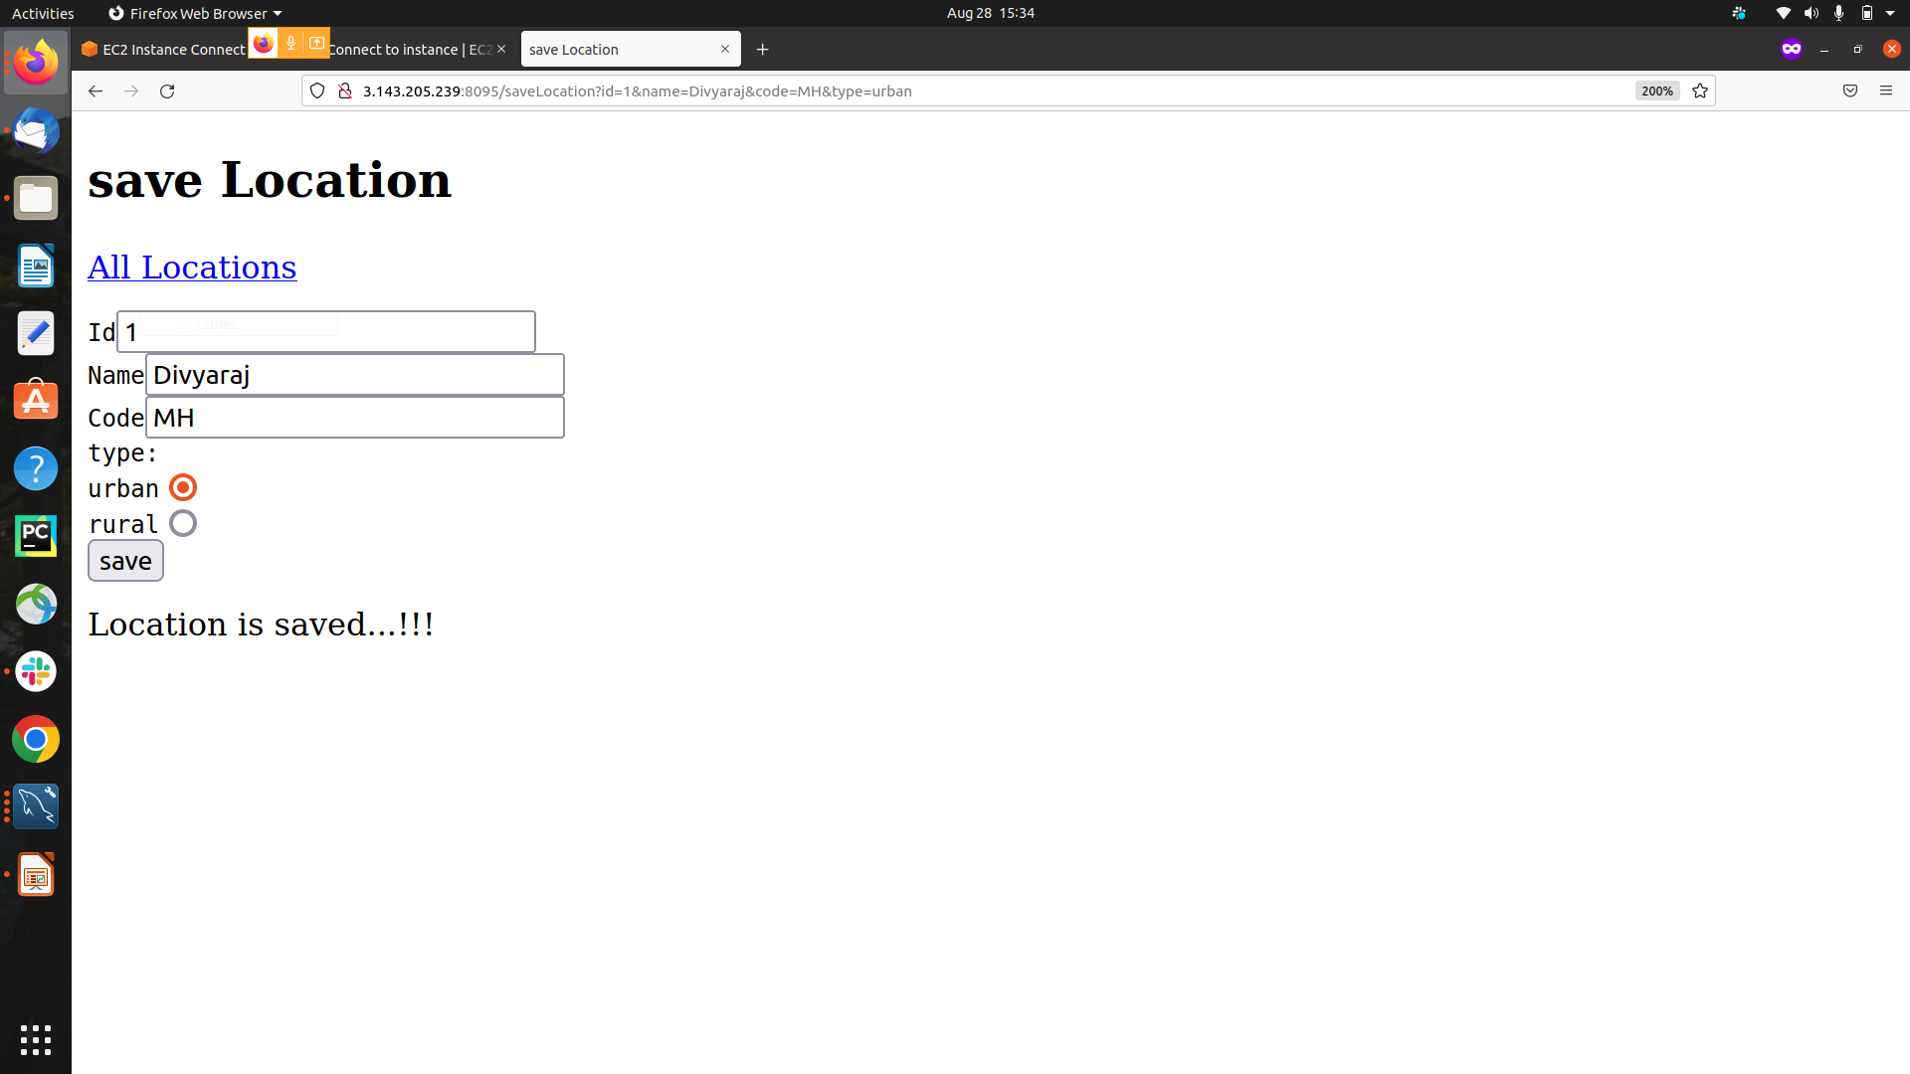

Slide 12
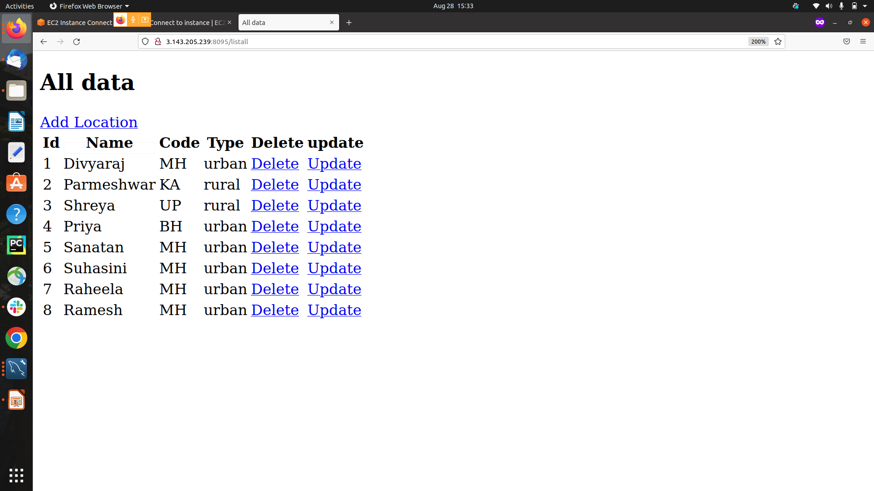

Slide 13
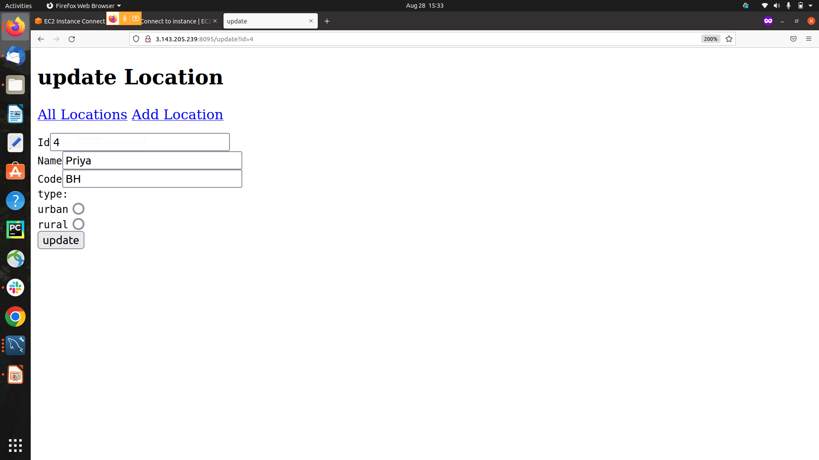
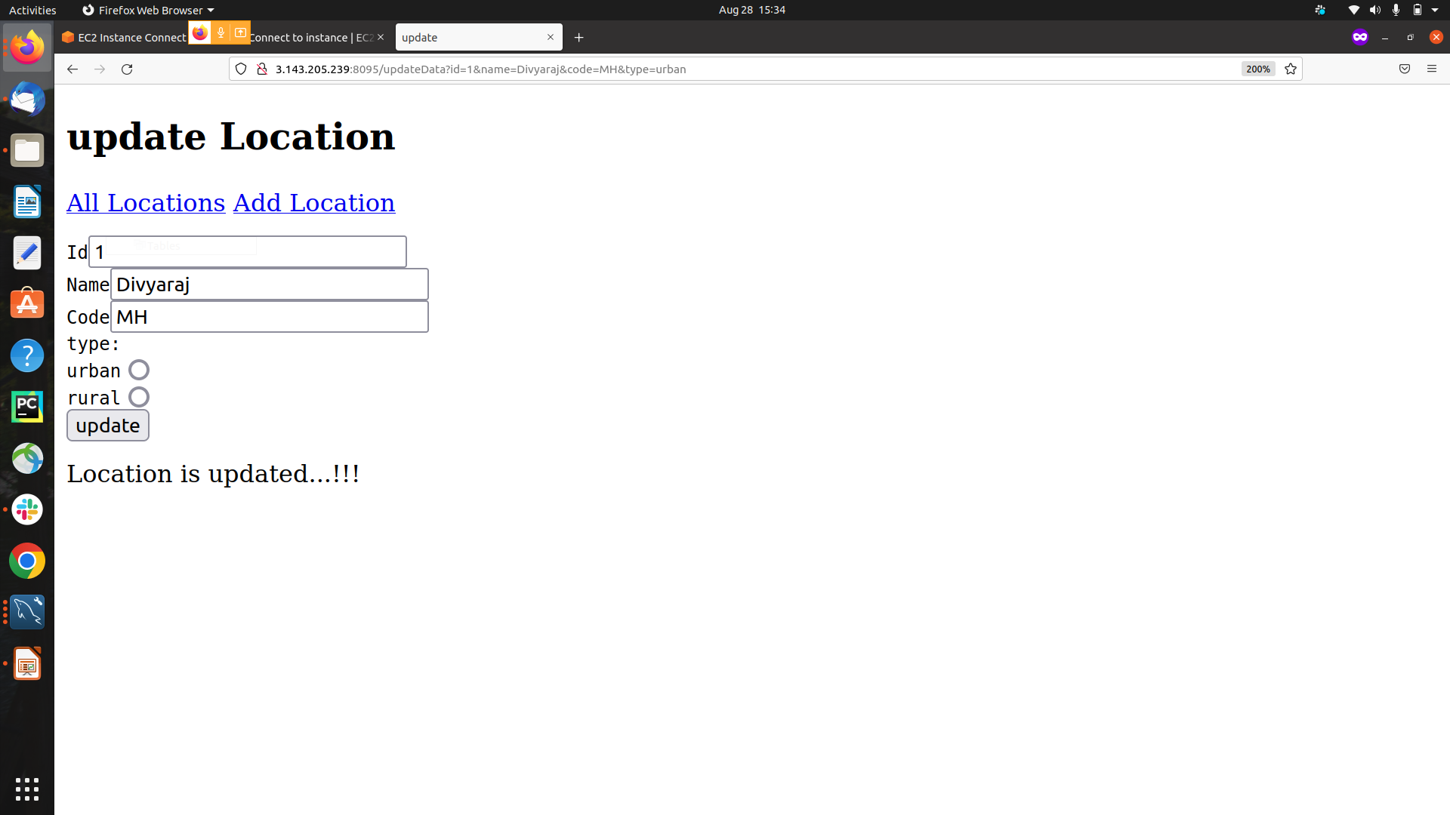

Slide 14








Technologies and Tools Used

Slide 15
Conclusion
This WebApplication is designed to help the user to Add,Update,Retrieve & Delete user information from the location form.

Slide 16


Slide 17
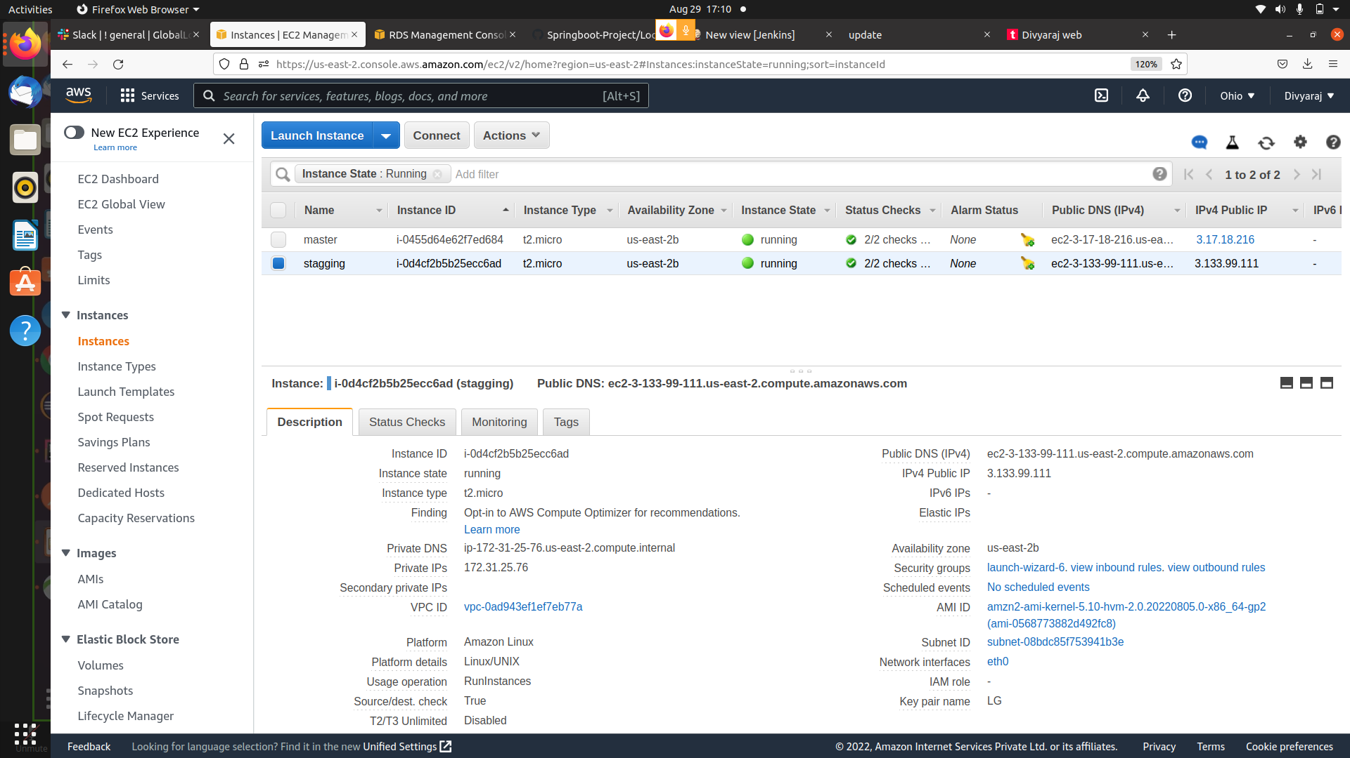

Slide 18
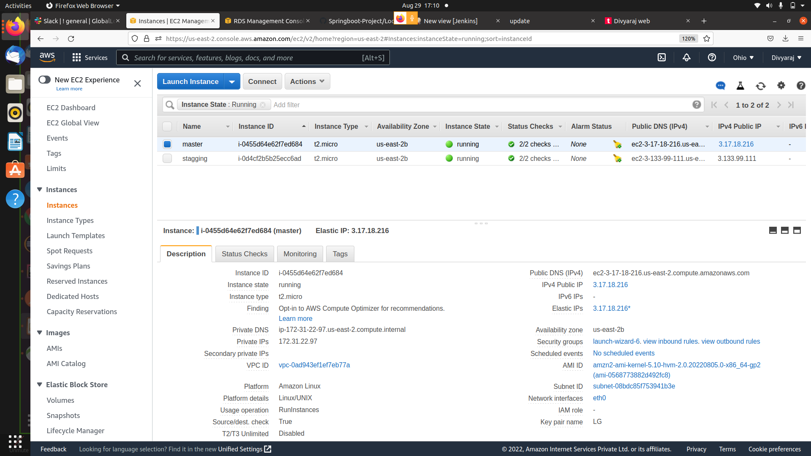

Slide 19
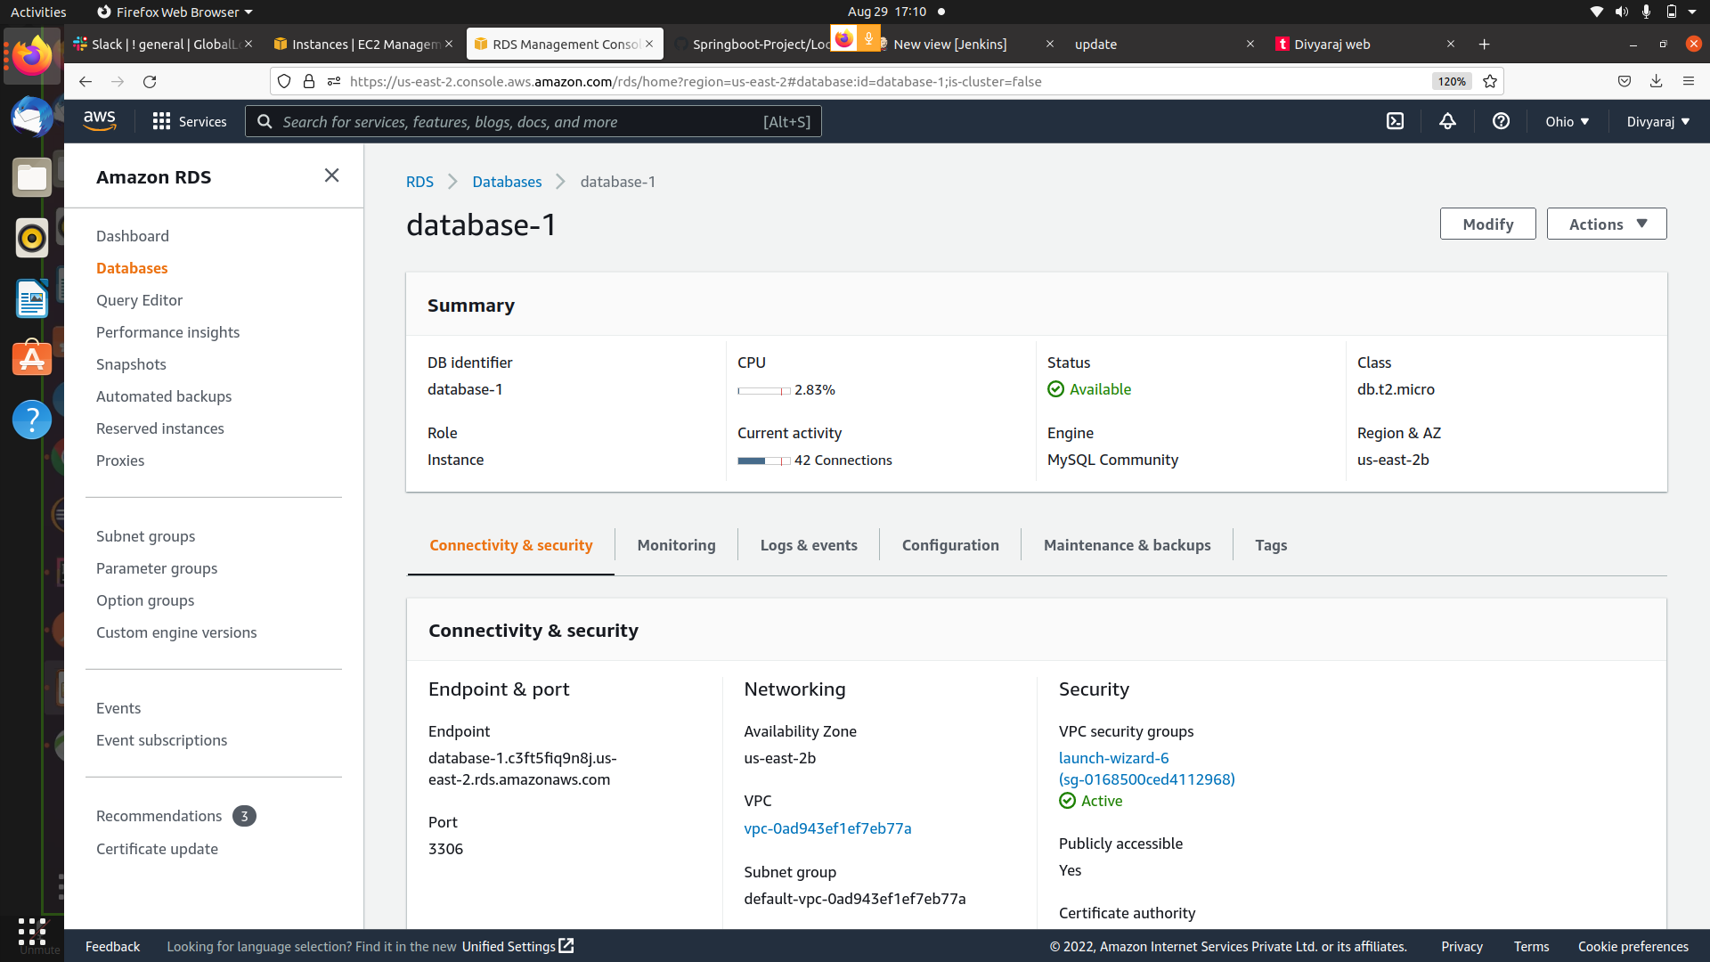

Slide 20
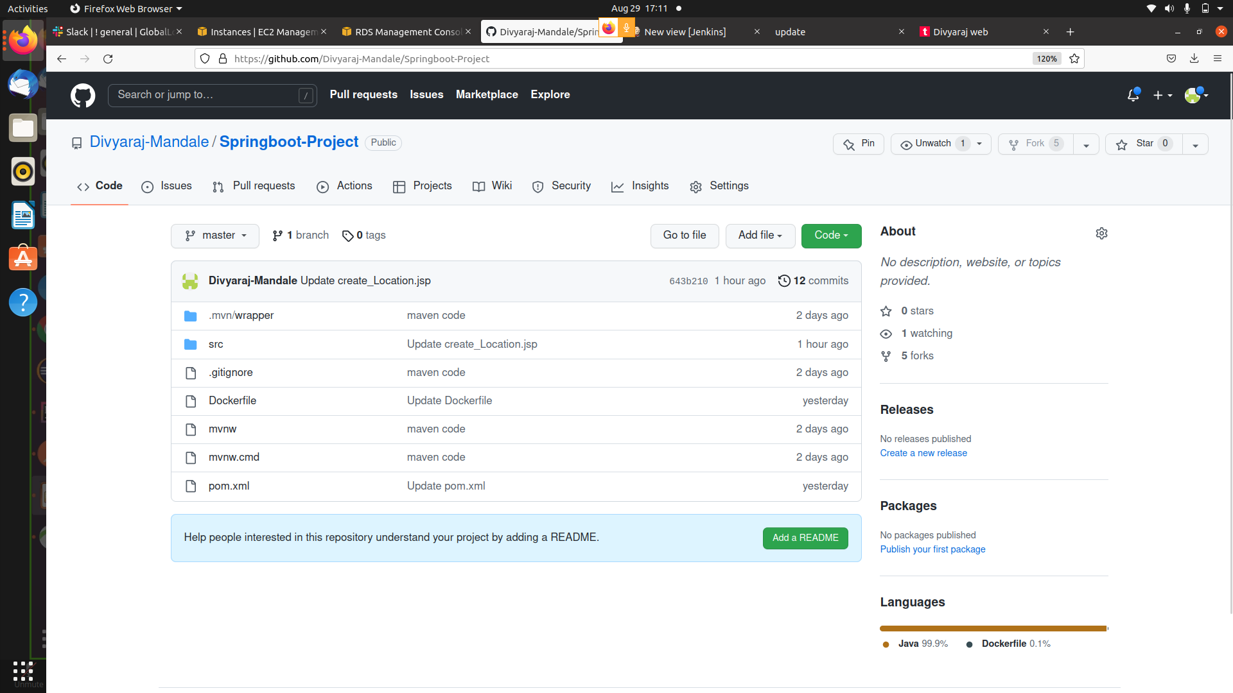

Slide 21
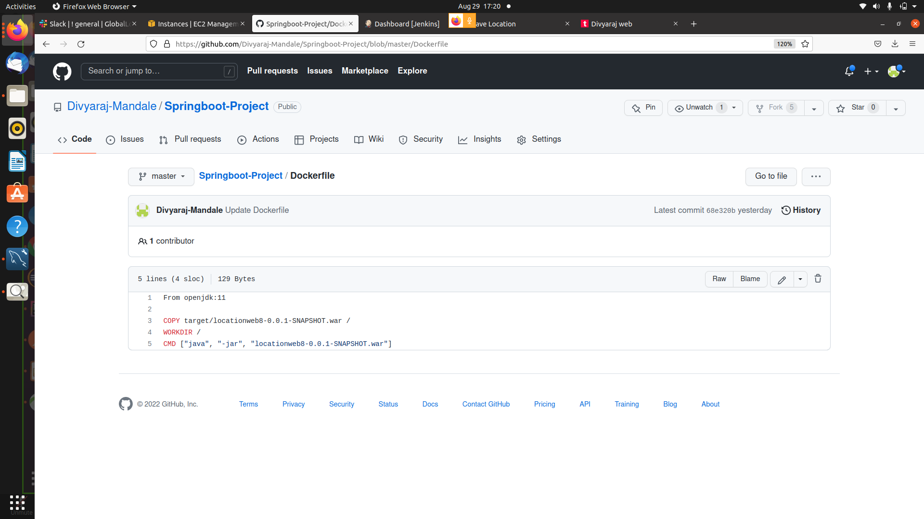

Slide 22
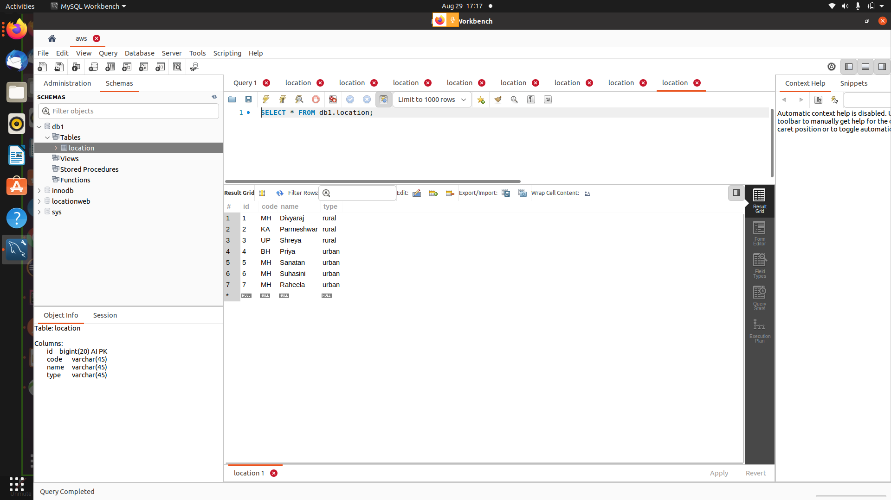

Slide 23
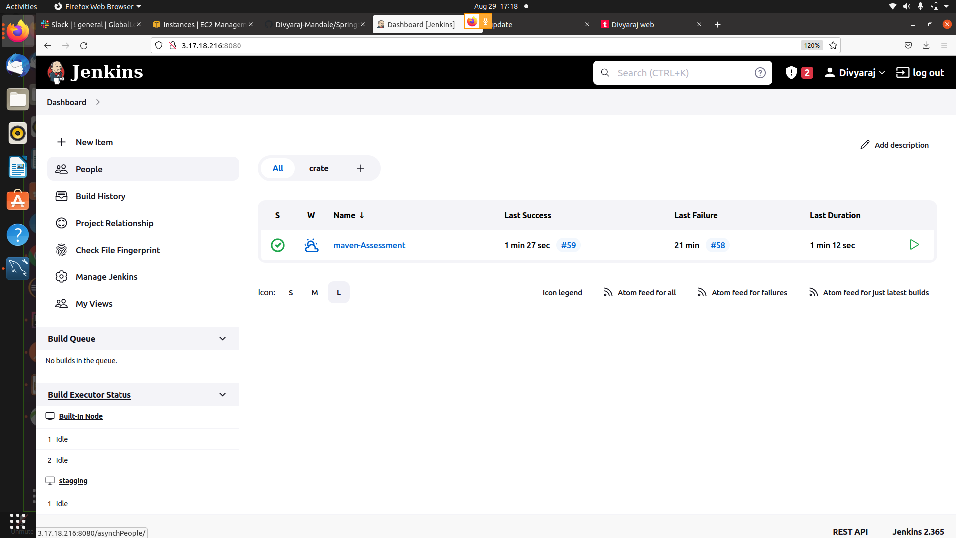

Slide 24
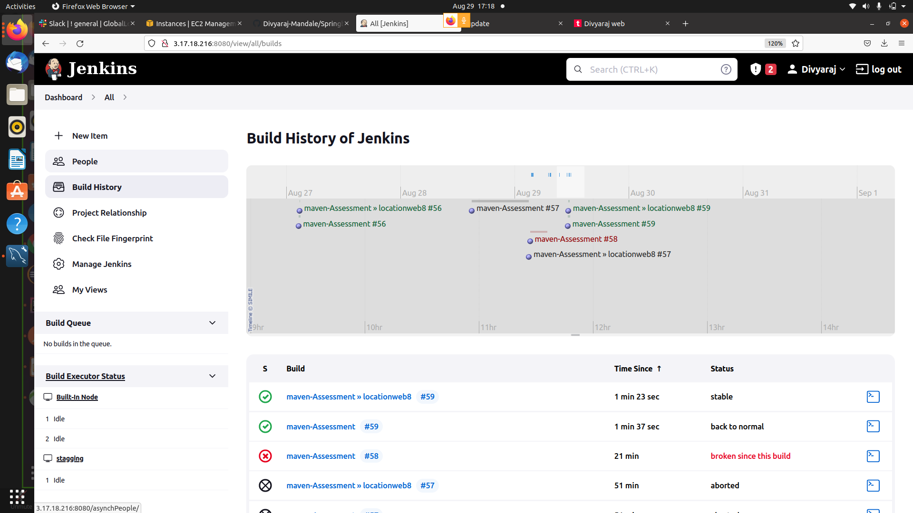

Slide 25
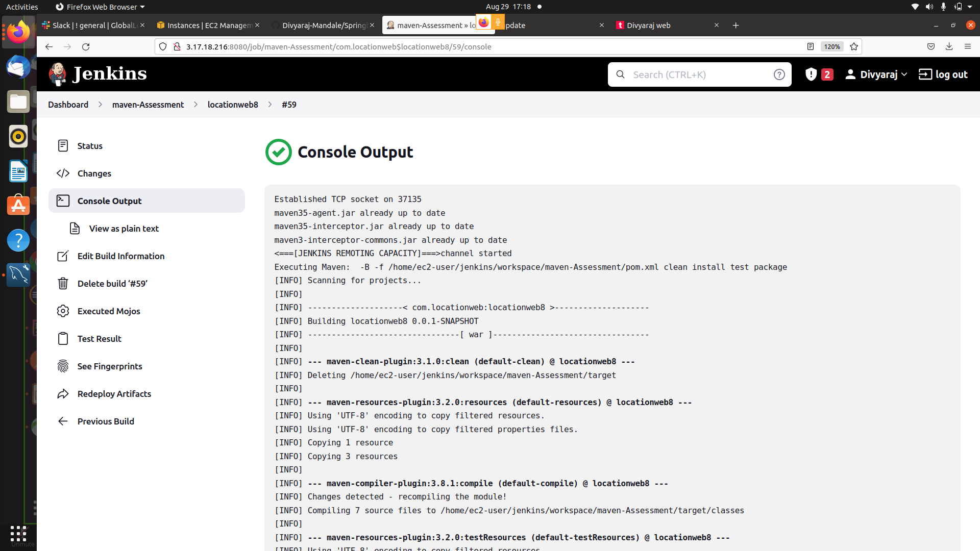

Slide 26
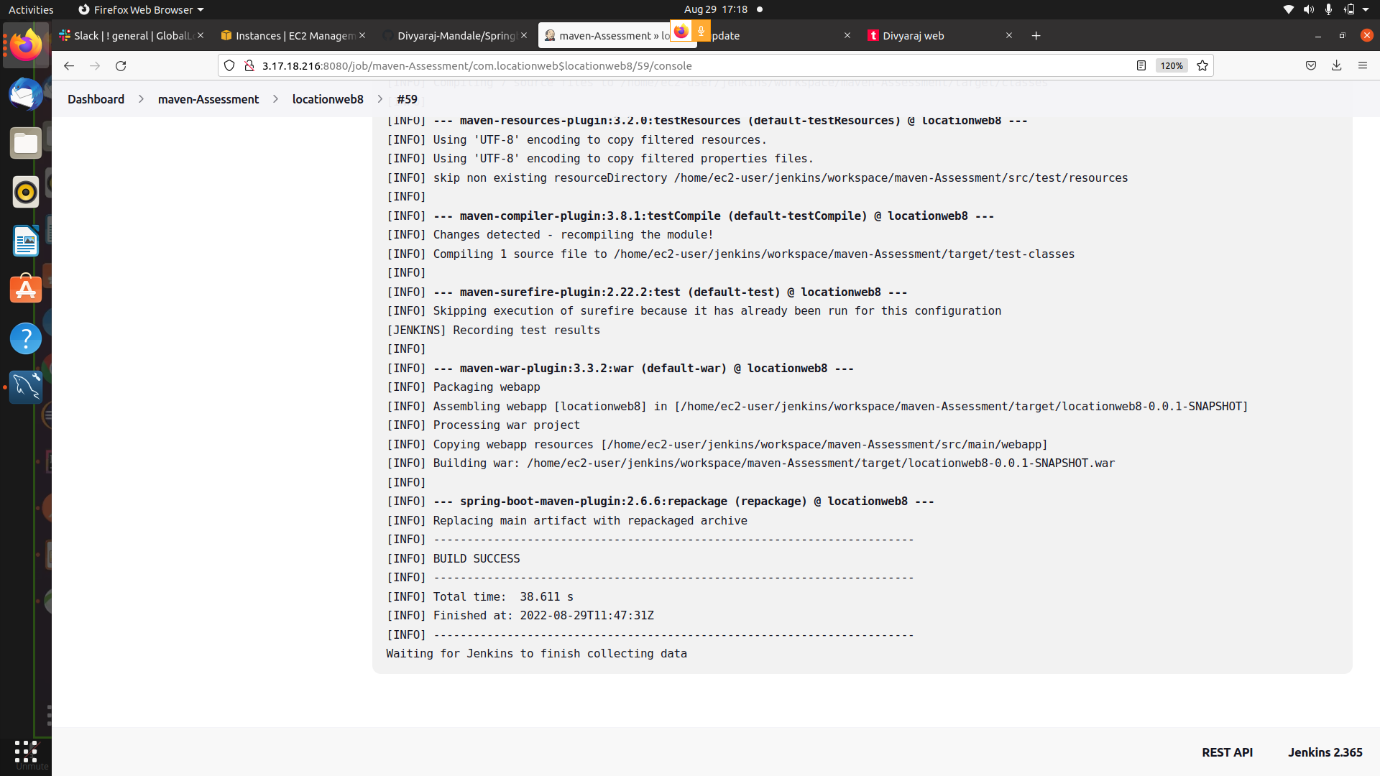

Slide 27
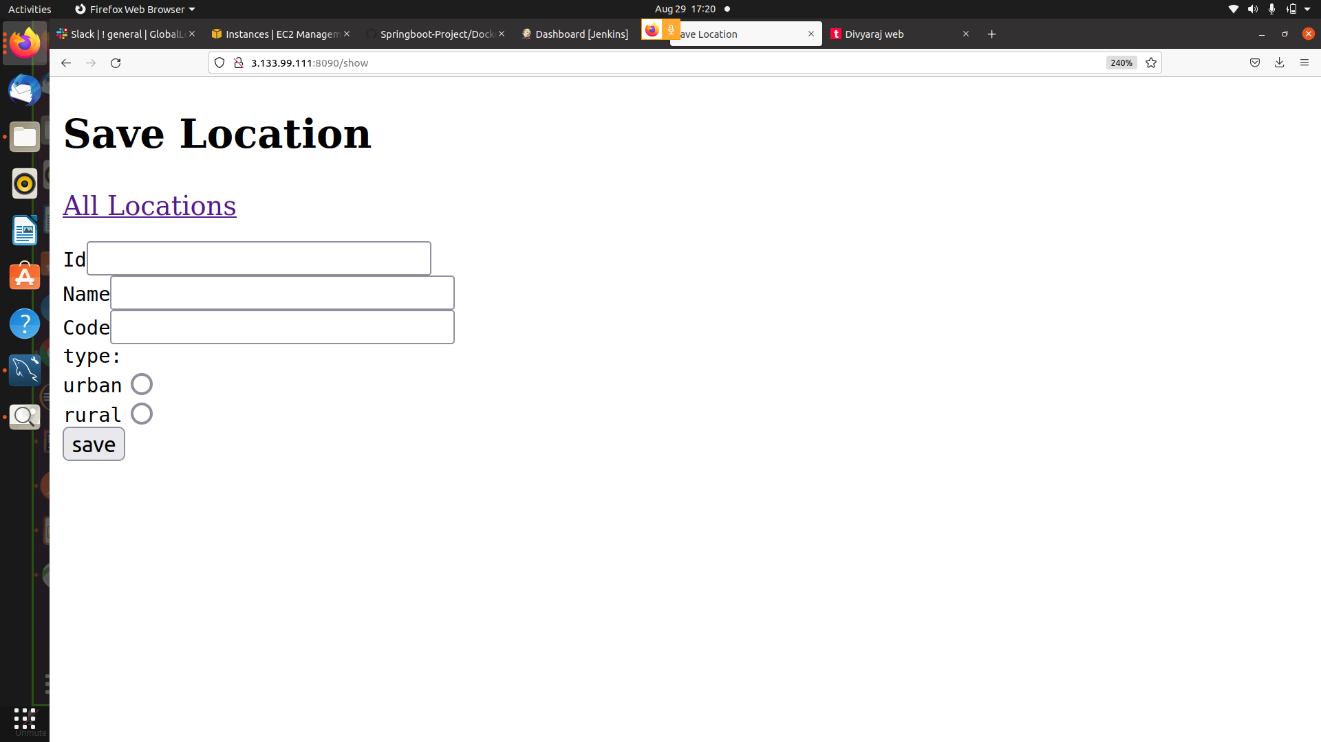

Slide 28
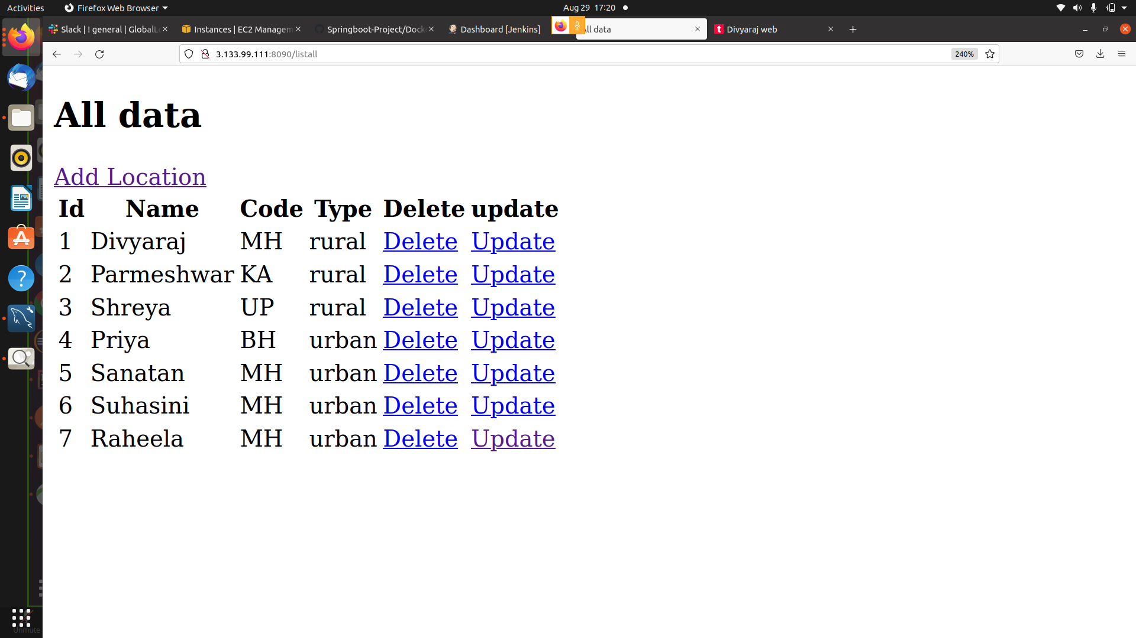

Slide 29
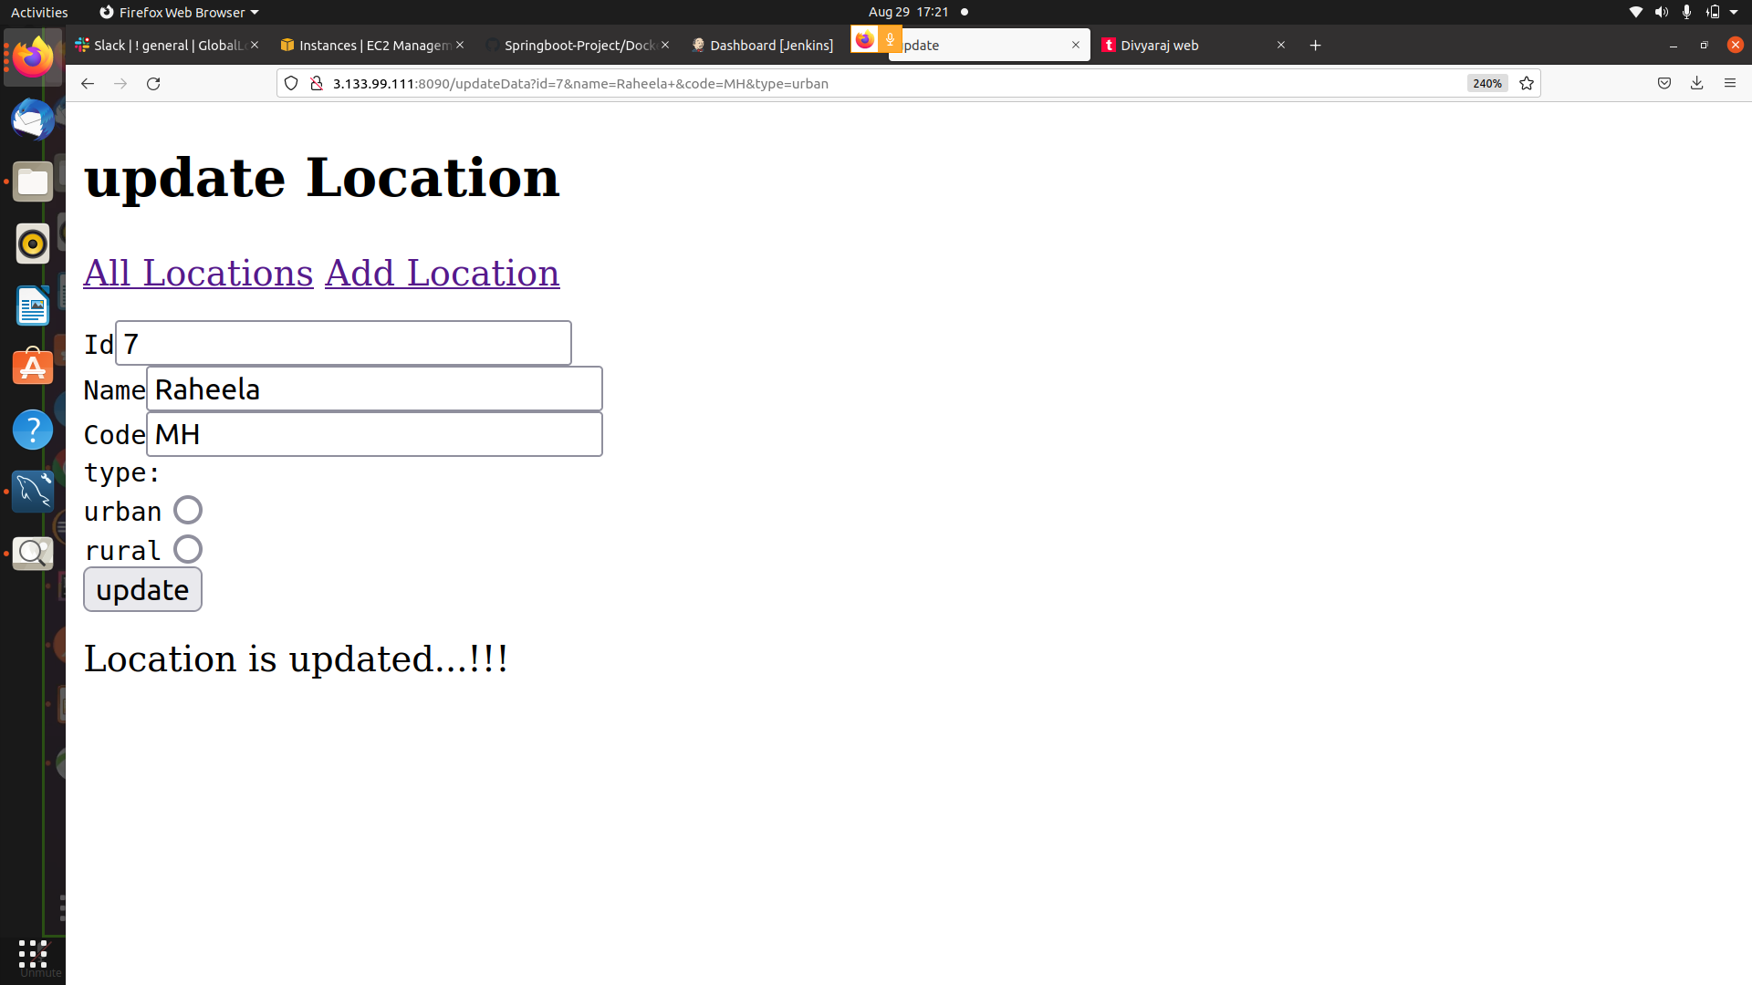

Slide 30
